Slide 1
Meet Walt Whitman and Me
student’s Name
Instructor’s Name
Course
Date

Slide 2
Introduction
My poetry works are inspired by Shakespeare and Walt Whitman
Walt Whitman was born in 1819 in New York.
He was the second son to Walter Whitman and Louisa Van Velsor.
He acquired limited formal education.
He worked as a printer, a teacher, reporter, and an editor.
Whitman is renowned for straightforward talk about sexuality and politics
In 1885, Whitman published the first edition of Leaves of Grass
Leaves of Grass comprised of twelve poems, his best-known work.

Slide 3
Personality Traits
1. Entrepreneurial and progressive:
Whitman worked in a law office before starting his printing business.
He acquired skills that he employed in publishing his poems.
2. Patient and Hardworking:
Whitman was calm as he worked towards his goals.
3. He was a leader:
He was determined and demanded freedom of thought.
Also, he always led from the forefront.

Slide 4
Beliefs and Values
Whitman valued democracy- was a way of experiencing the world.
He believed that democracy- was a means of interpersonal interactivity
He championed of equality- Announced the fairness for all people (Huang, p.103).
His poem “Song of Myself” advocated for equality.

Slide 5
Poetic Talents
1. Stylistic innovation:
Whitman began poetry when poets were guided by predetermined rules.
The rules determined the form, content, and style (Allison, p.1).
He developed his own technique for poetry, poems without rhyme and meter.
2. Whitman linked his poems with the democratic experiment.
3. He managed to employ Biblical poetry strategies in his poems.

Slide 6
Flaws
Whitman was perceived as imperfect because of two main reasons:
Style- He disregarded the rules of writing poems
Discrimination- He had little compassion for the minority, for example, African Americans

Slide 7
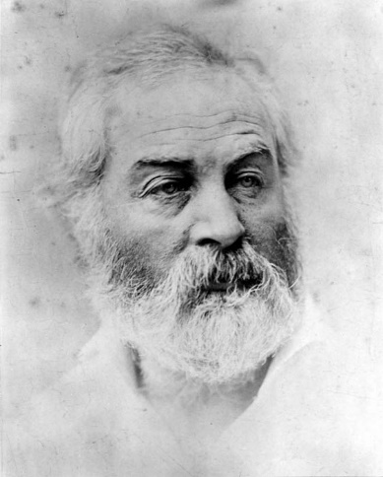
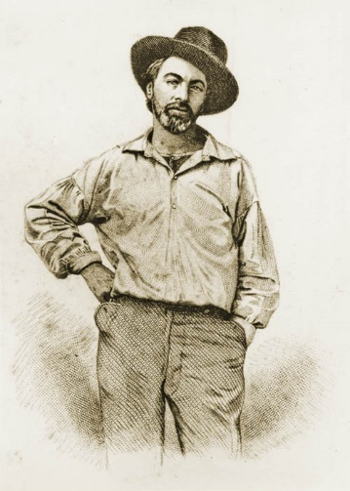
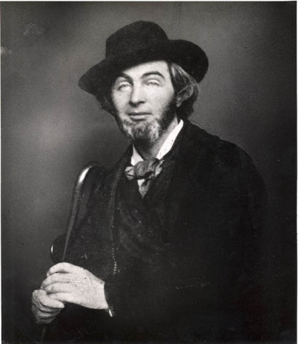
Photos
Whitman Photos
My photos
(Walt Whitman Archive)

Slide 8
Whitman's Poems that Reveal his Character
I Hear America Singing
I HEAR America singing, the varied carols I hear;
Those of mechanics—each one singing his, as it should be, blithe and strong;
The carpenter singing his, as he measures his plank or beam,
The mason singing his, as he makes ready for work, or leaves off work;
This poem portrays Whitman as individualism, their own personalized songs.

Slide 9
My Poem
Success
Success is forever sweet though it’s not immediately,
It requires sacrifice and so don’t give up completely,
Failure is vital ingredient for success,
Handwork is the driver for successes.
This poem may portray me as hardworking and being successful.

Slide 10
Whitman Human Qualities
Empathetic- During the Civil War he had volunteered as a nurse (Biography, p1).
Hardworking- He started supporting his family at an early age.
Creative- He invented his own way of writing poems.

Slide 11
Conclusion
Walt Whitman was born in 1819 from a poor family.
He started working at an early age to support his family.
He worked as a teacher, reporter, and an editor.
In 1855 he published the first edition of Leaves of Grass.
His poetic talents include his stylistic innovation
His characters include being empathetic, hardworking, creative.

Slide 12
Works Cited
Allison, Chris. "How Walt Whitman Changed The World of Poetry & What You Can Learn From It." 3 June 2010. 8 June 2019. Accessed from <https://www.neboagency.com/blog/lesson-walt-whitman-audacity/>.
Biography. Walt Whitman Biography. 18 April 2019. 8 June 2019. Accessed from <https://www.biography.com/writer/walt-whitman>.
Huang, Chi -Erh. "Layers of Equality Noticed in Walt Whitman's Leaves of Grass." (2017): 101-115. Accessed from <http://ir.nptu.edu.tw/bitstream/987654321/19227/1/101.pdf>.
Walt Whitman Archive. Pictures & Sound. 2019. 8 June 2019. Accessed from <https://whitmanarchive.org/multimedia/gallery.html>.

